Slide 1

Convolutional Neural Networks (CNN) for Structural Damage Classification in Civil Infrastructure
Presented By:
N Varshini (21RH1A05G6)
P Nandini (21RH1A05J8)
P Mohana (21RH1A05K4)

Slide 2
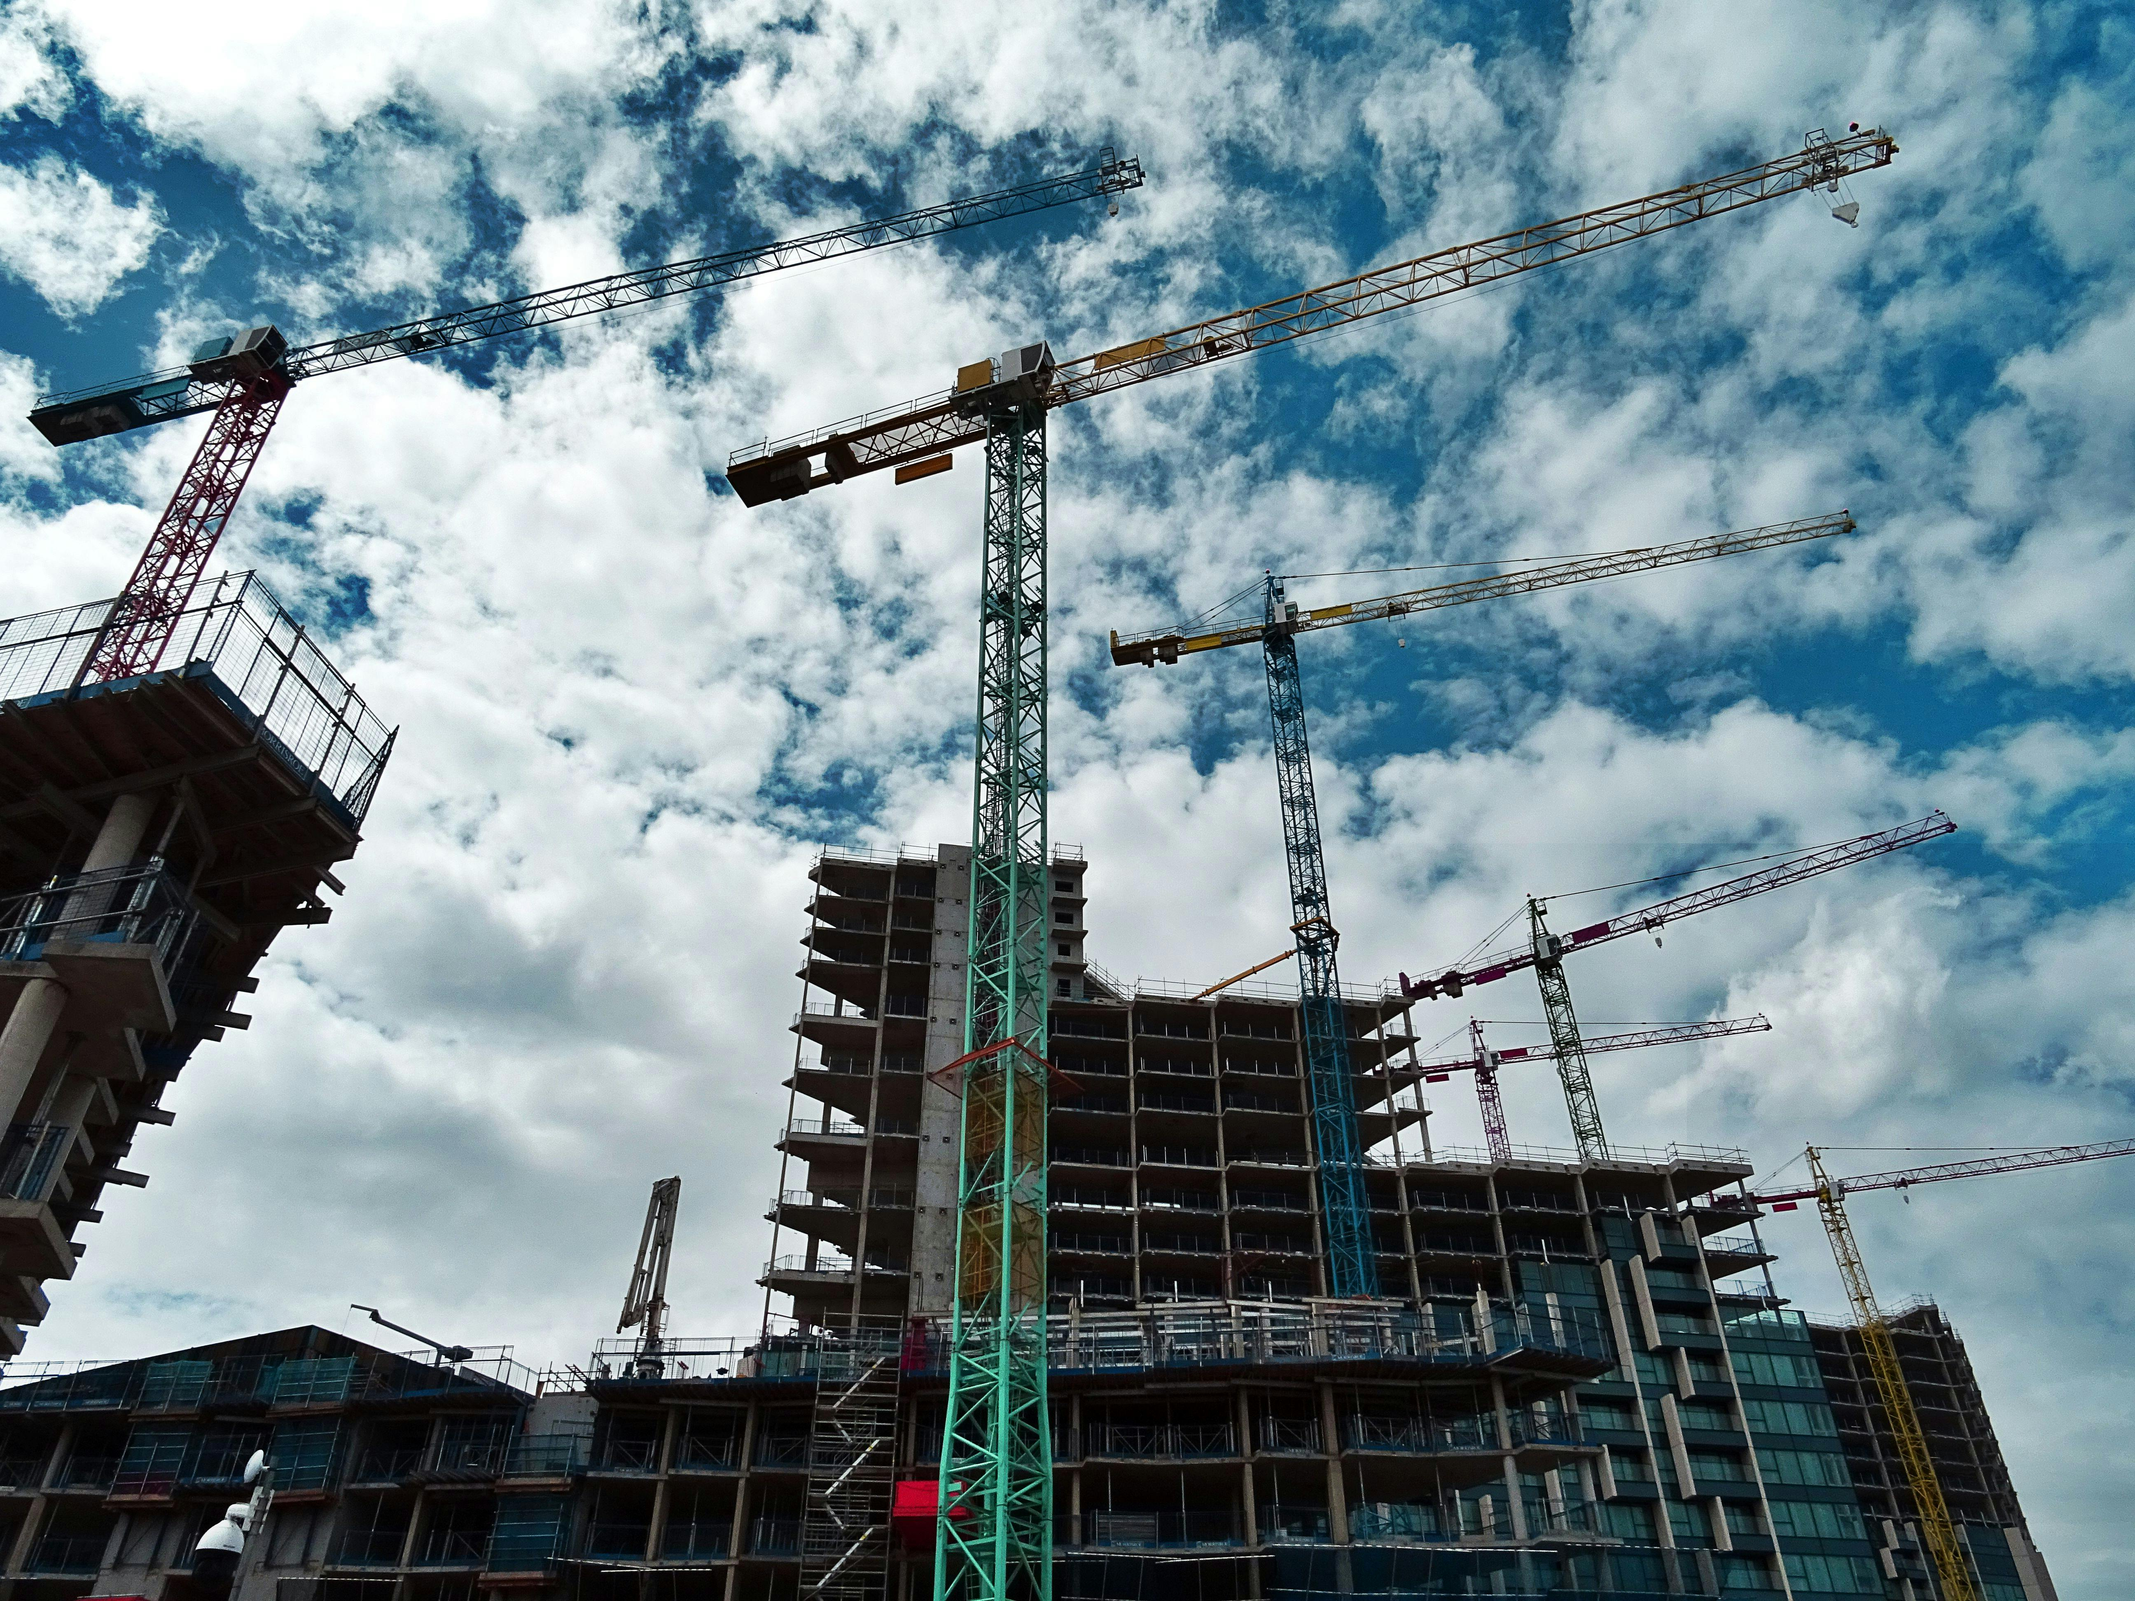
AGENDA
Introduction
Existing System & Proposed System
Key Features
Methodology
Challenges
Output Screens
Conclusion
Future Scope

Slide 3
INTRODUCTION
Civil infrastructure, such as bridges, buildings, and roads, is critical to the functioning of modern society, but maintaining its safety and reliability is a growing challenge. Structural damage from aging, environmental factors, and natural disasters can compromise their integrity, leading to safety risks and costly failures.
Traditional inspection methods are often time-consuming, labor-intensive, and subjective, making it difficult to identify early-stage damage or monitor infrastructure at scale.
This project addresses these challenges by leveraging deep learning techniques, particularly Convolutional Neural Networks (CNNs), for detection and classification of structural damage. By analyzing images of infrastructure, CNNs can quickly and accurately identify issues like cracks, corrosion, or deformation, providing a scalable and objective solution.

Slide 4
EXISTING SYSTEM
Traditional methods for inspecting civil infrastructure, such as bridges, buildings, and roads, rely on manual efforts where inspectors visually assess structural conditions. These methods are time-consuming, subjective, and inefficient, especially for large-scale or inaccessible structures. Subtle damages like micro-cracks or internal defects are often missed, and the quality of assessments depends heavily on the experience of the inspector. While some semi-automated tools, such as sensors and cameras, assist in data collection, the interpretation remains largely manual, limiting precision and scalability.
PROPOSED SYSTEM
The proposed system uses deep learning and Convolutional Neural Networks (CNNs) for the detection of structural damage in infrastructure like bridges and buildings. By analyzing images from cameras, the system can quickly identify cracks, rust, or other damages with high accuracy. This eliminates the need for time-consuming manual inspections and provides a scalable, efficient solution for monitoring large structures. It also improves over time as it learns from new data, offering real-time damage reports that help in proactive maintenance, reducing both costs and safety risks.

Slide 5
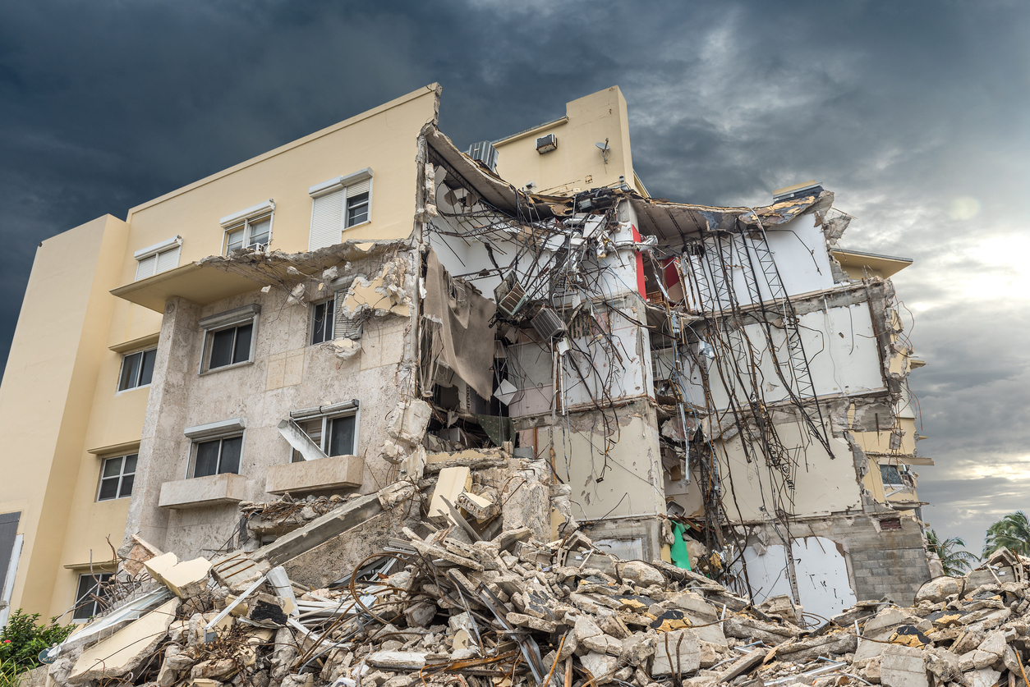
KEY FEATURES
The proposed system offers several key features, including damage detection, real-time analysis, scalability, and cost effective.
These features enhance the system's ability to quickly identify and classify structural issues, enabling efficient and accurate maintenance decisions, while reducing costs and improving the safety of infrastructure.

Slide 6
METHODOLOGY:
DATA SET
PREPROCESSING
TRAIN & TEST , SPLITTING
MODEL PREDICTION
RESULT AND ACCURACY

Slide 7
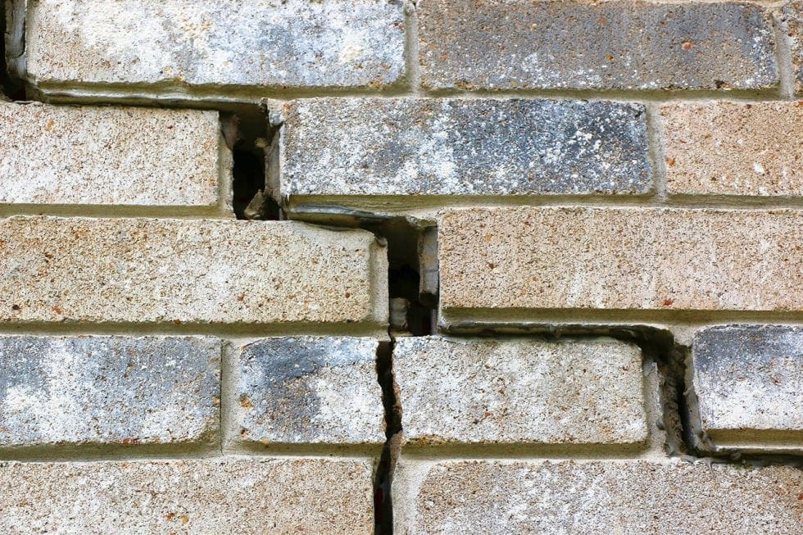
CHALLENGES in Structural Damage Detection
Complex Damage Types
Scalability for Large Structures
Training Time and Cost
False Positives and Negatives
Adapting to Diverse Structures
Post-Processing Complexity

Slide 8

OUTPUT SCREENS:

Slide 9


Slide 10


Slide 11


Slide 12
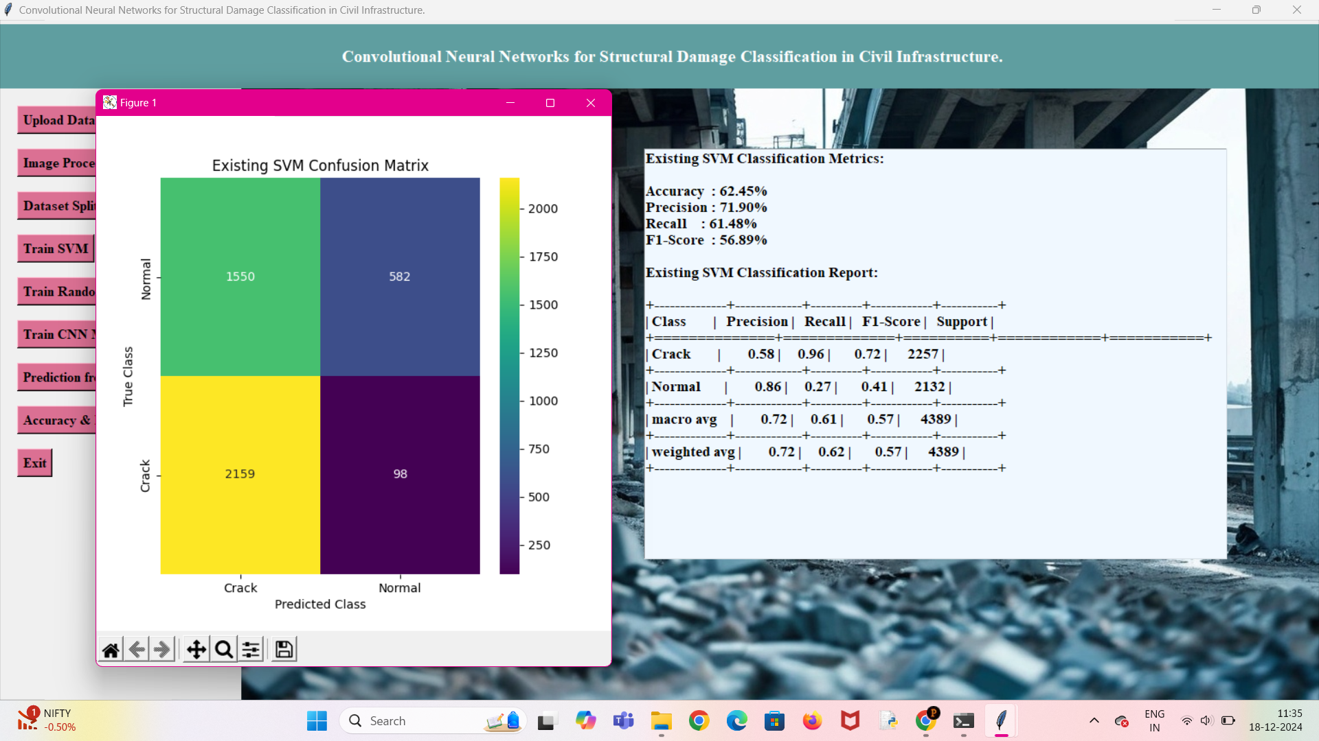

Slide 13
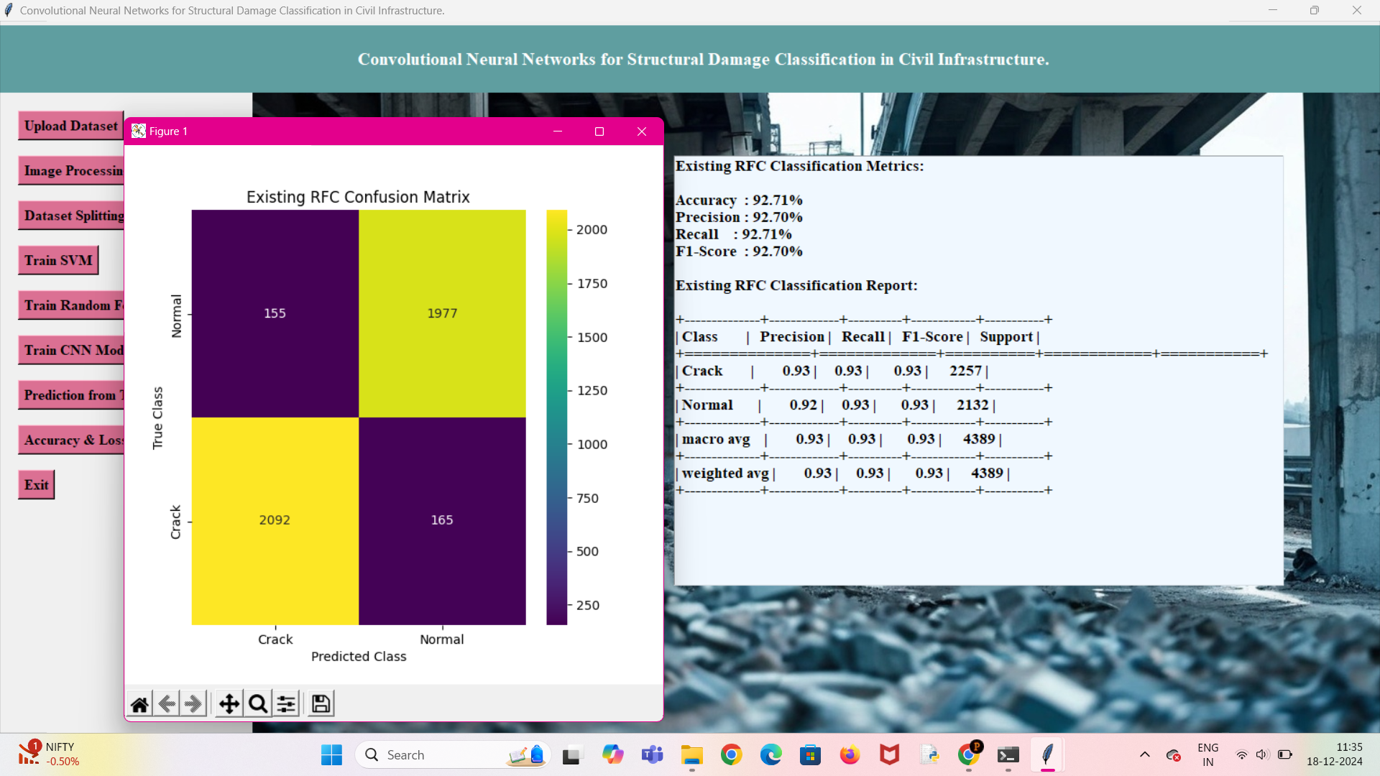

Slide 14
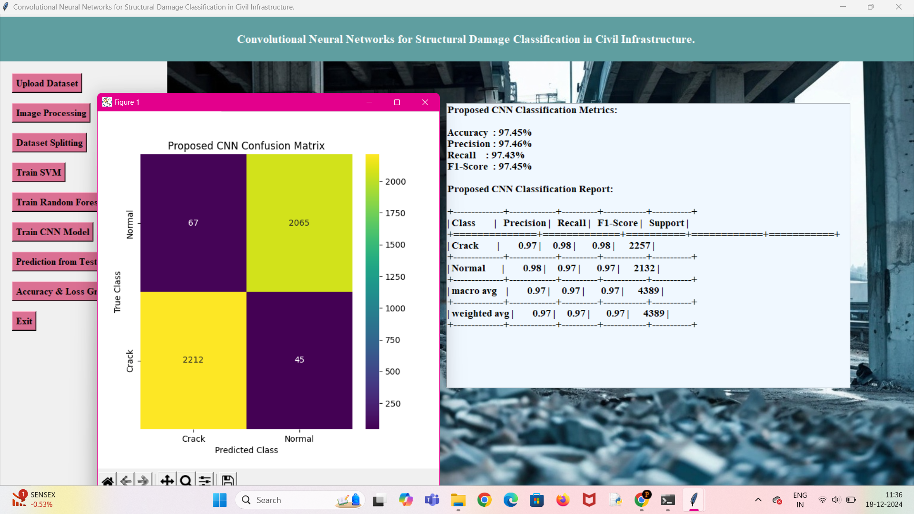

Slide 15
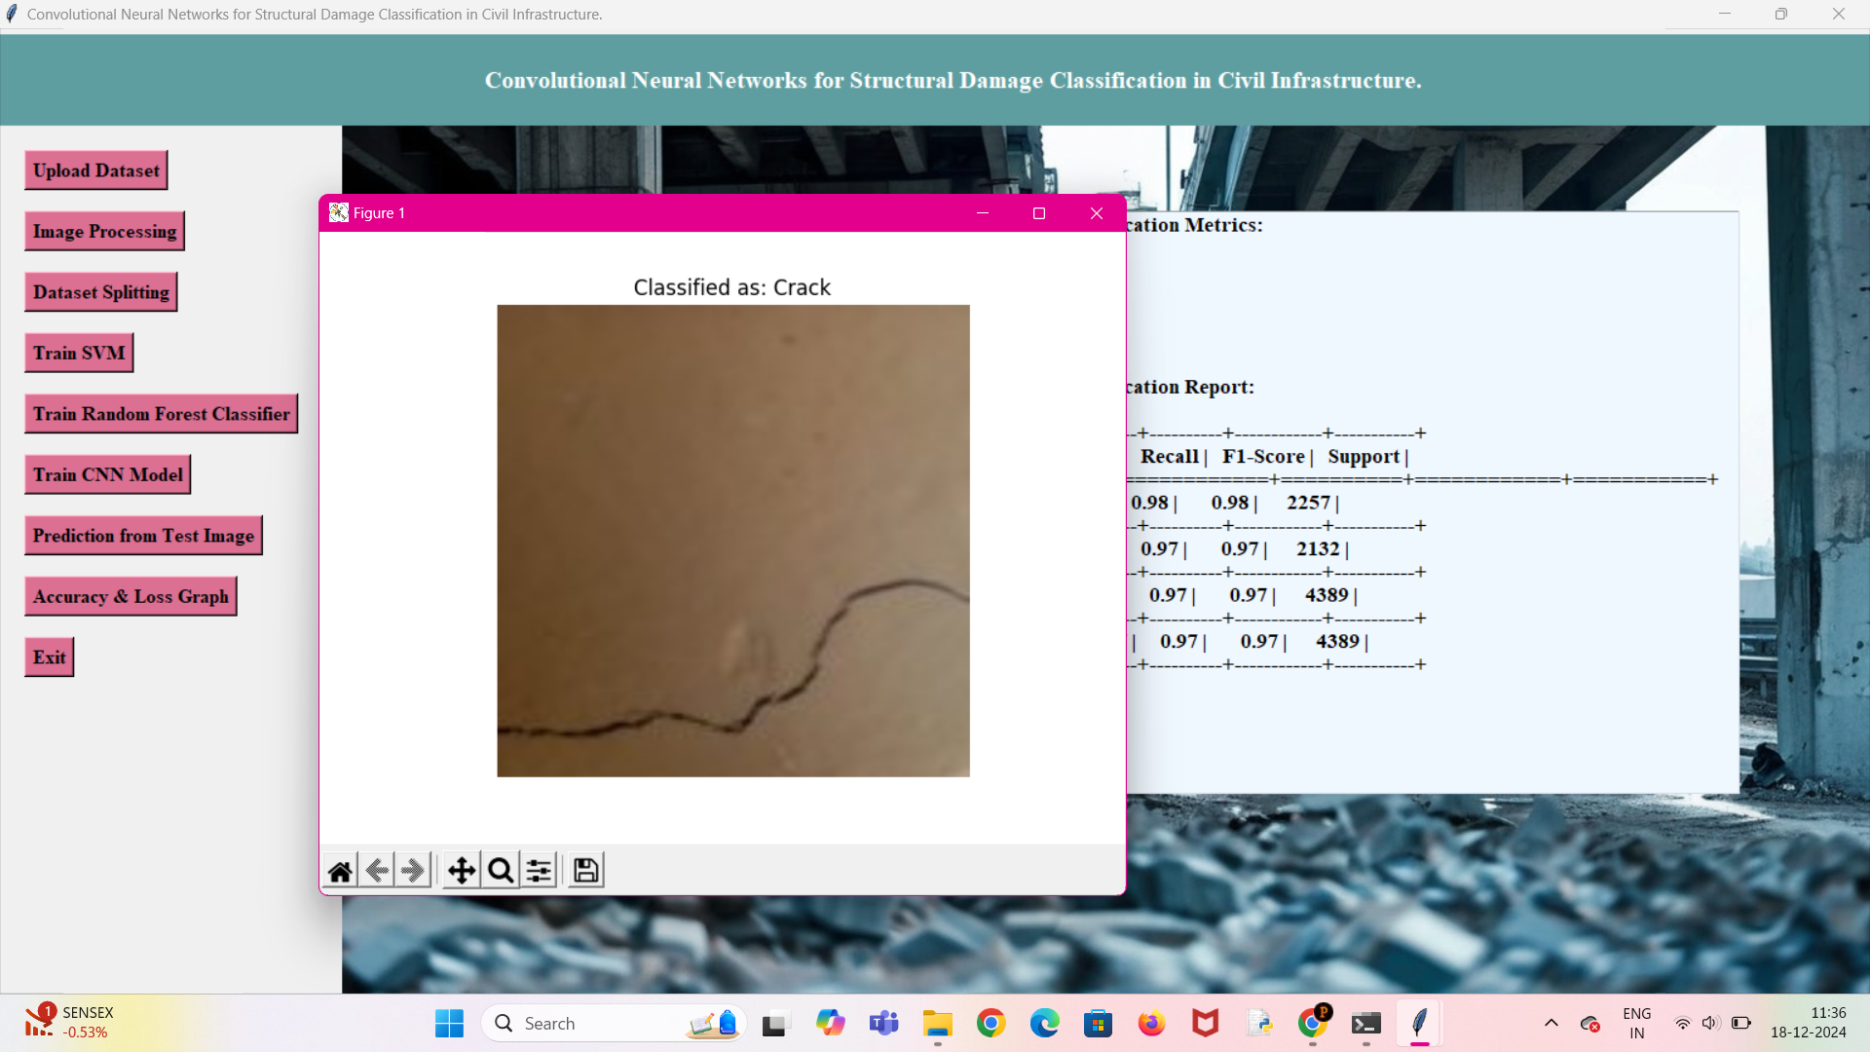

Slide 16
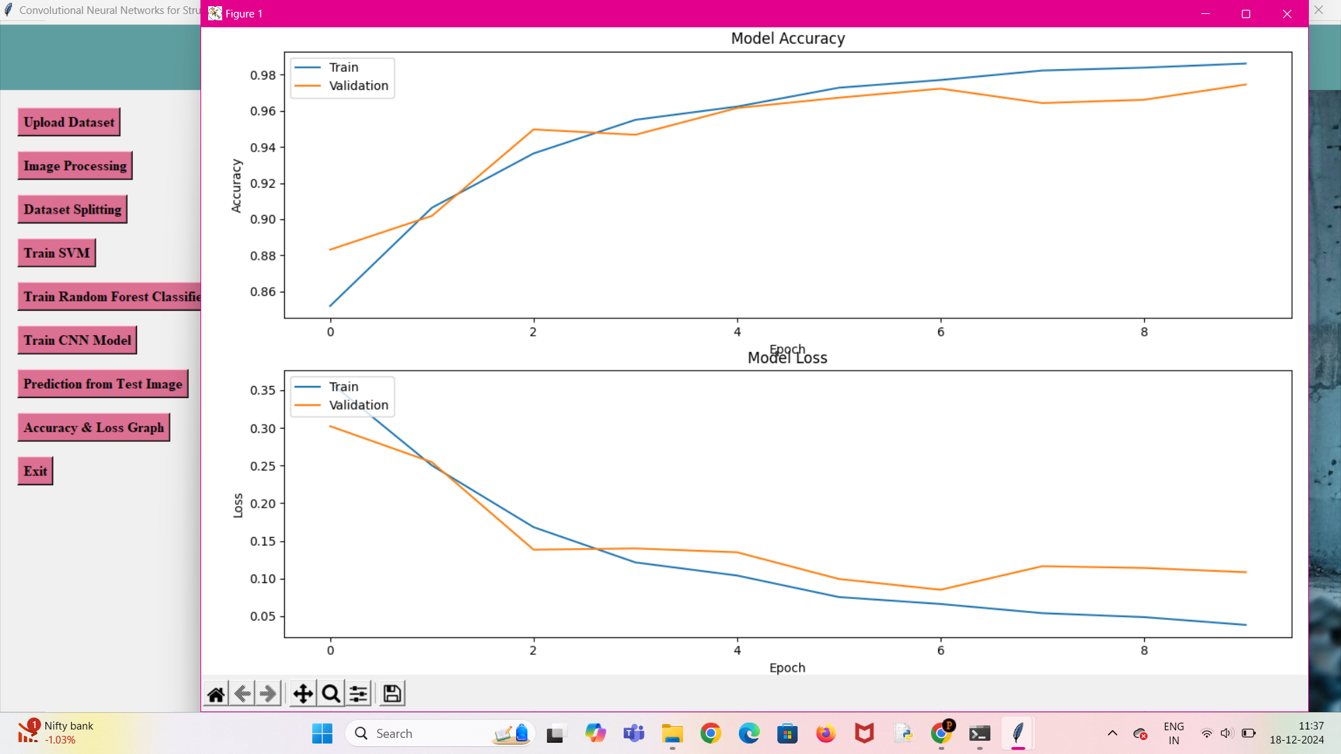

Slide 17

CONCLUSION
In conclusion, using deep learning for structural damage detection improves accuracy, reduces costs, and enhances safety. This automated approach ensures efficient maintenance, prolonging the lifespan of critical infrastructure.

Slide 18
FUTURE SCOPE
The future scope of this project includes integrating IoT devices for real-time monitoring, enhancing predictive capabilities, and expanding support for diverse materials and infrastructure types. It can scale globally, incorporate AR/VR for better analysis, and integrate with robotics for inspections and repairs. With continuous learning models and potential adoption in disaster management and policy standards, this system promises to revolutionize infrastructure maintenance and safety.

Slide 19


